Slide 1



Flutter Advanced Widgets

Slide 2
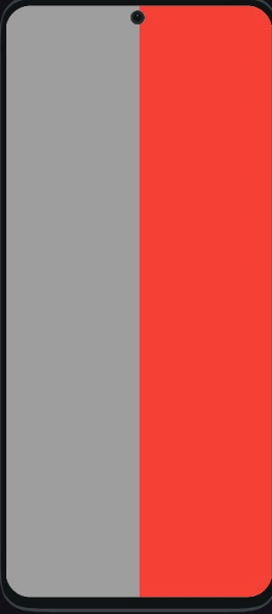

Slide 3
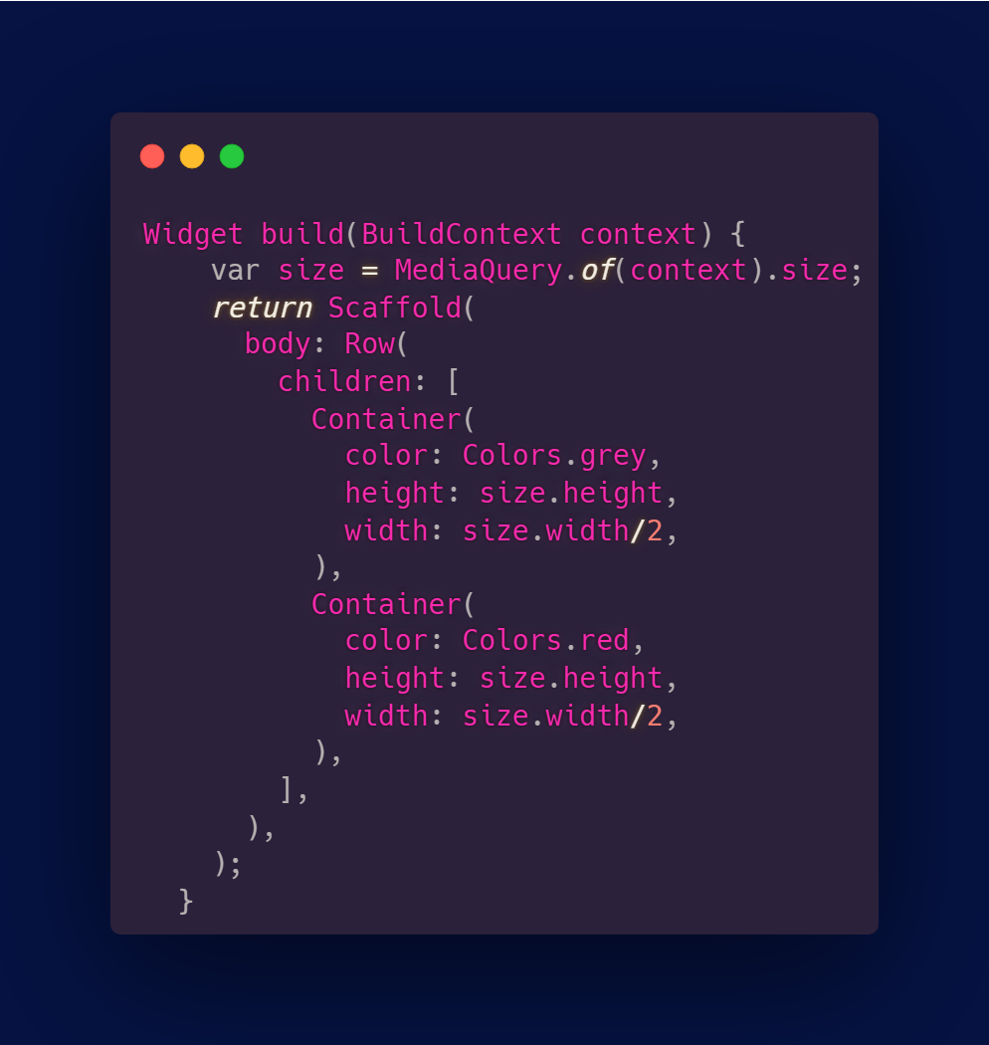
Media Query
MediaQuery allows you to access information about the current deviece’s screen size, orientation and user prefrences.

Slide 4
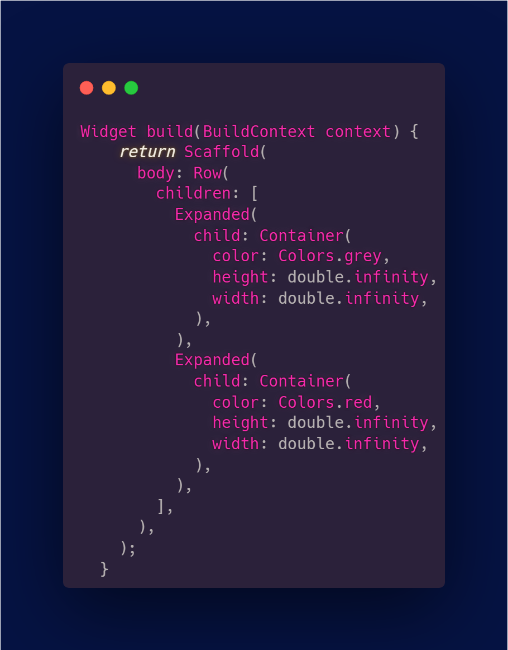
Expanded
A child of an Expanded widget takes the available space along the main axis.

Slide 5
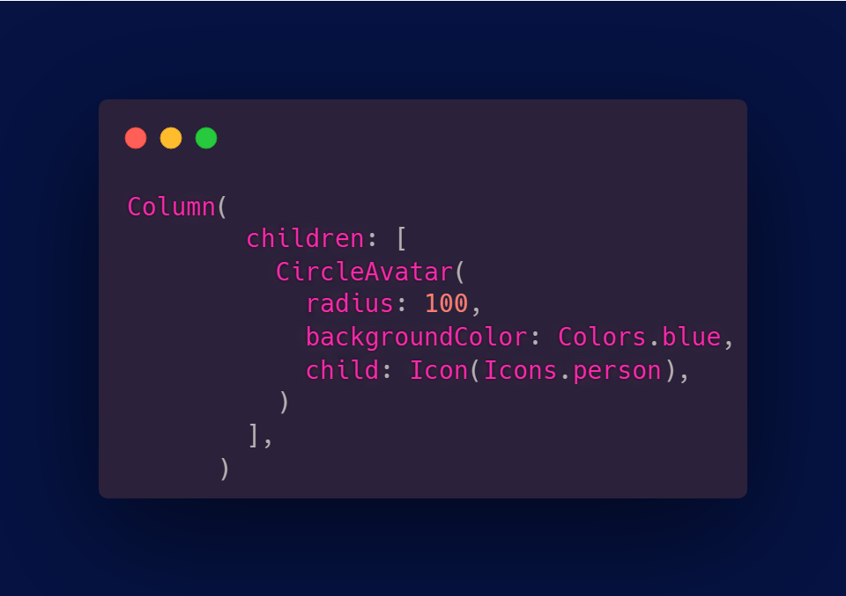
Circle Avatar
CircleAvatar is simply a circle where we can add background color, background image, or just some text. It usually represents a user with his image or with his initials.

Slide 6
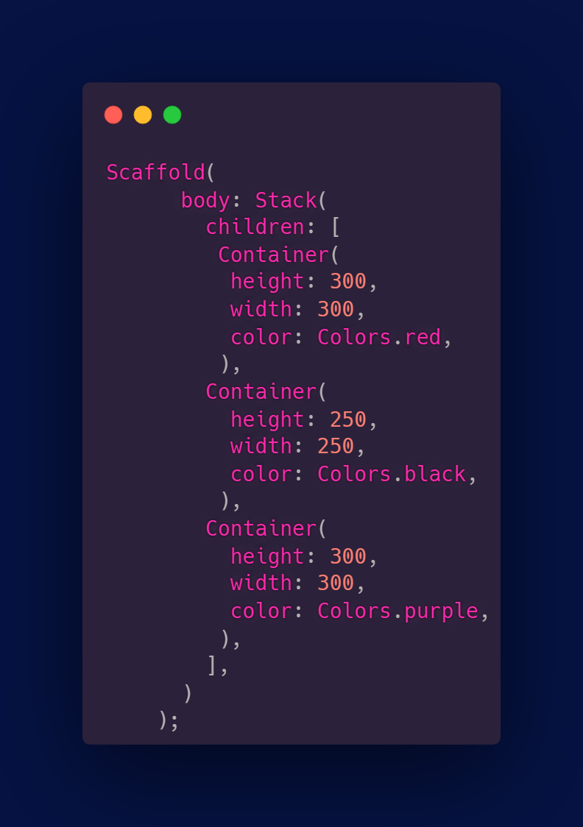
Stack
Stack widget allows for the layering of multipule widgets on top of each other.

Slide 7
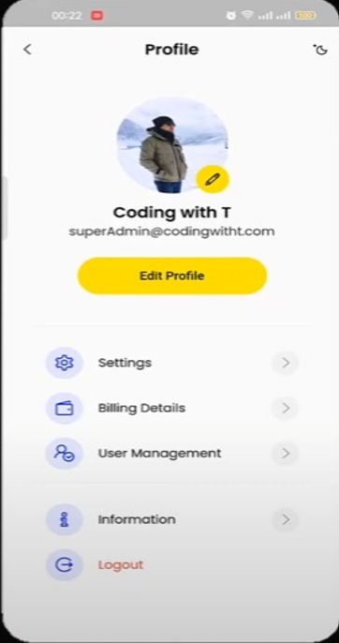
Hands on

Slide 8
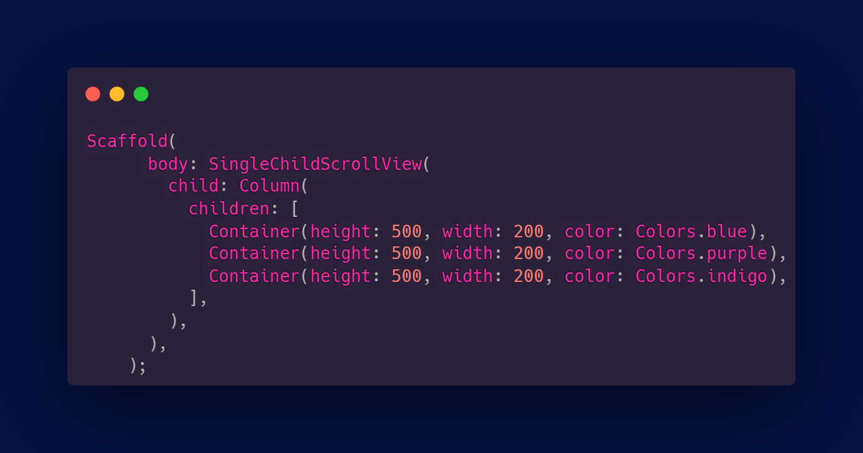
Single child scroll view
A box in which a single widget can be scrolled.

Slide 9
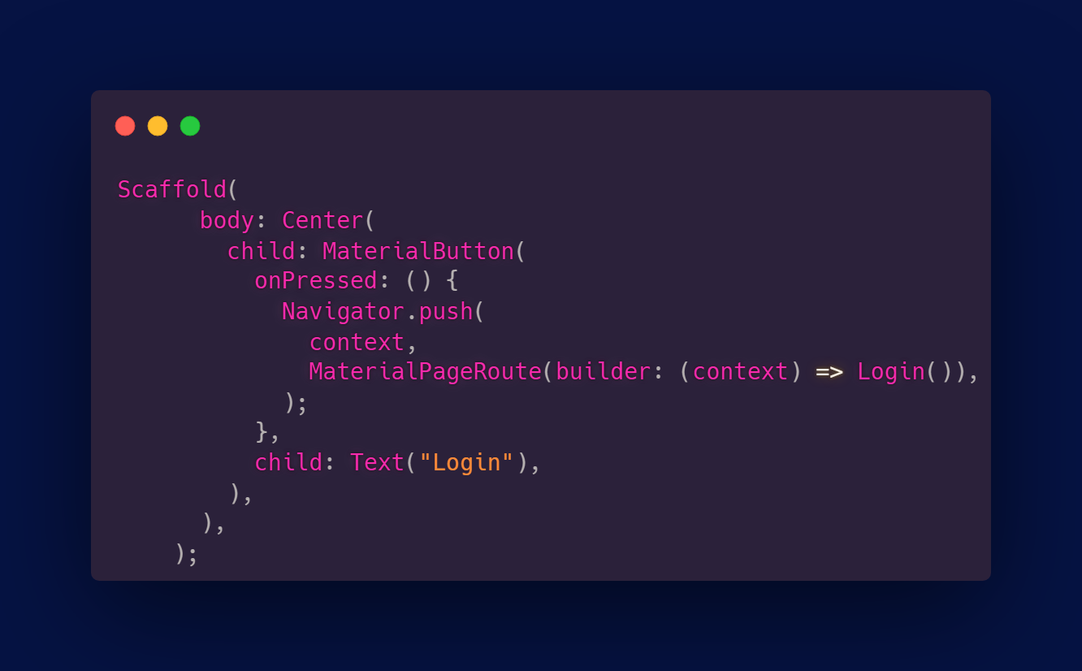
Navigator
To switch from one screen to another in the app.

Slide 10
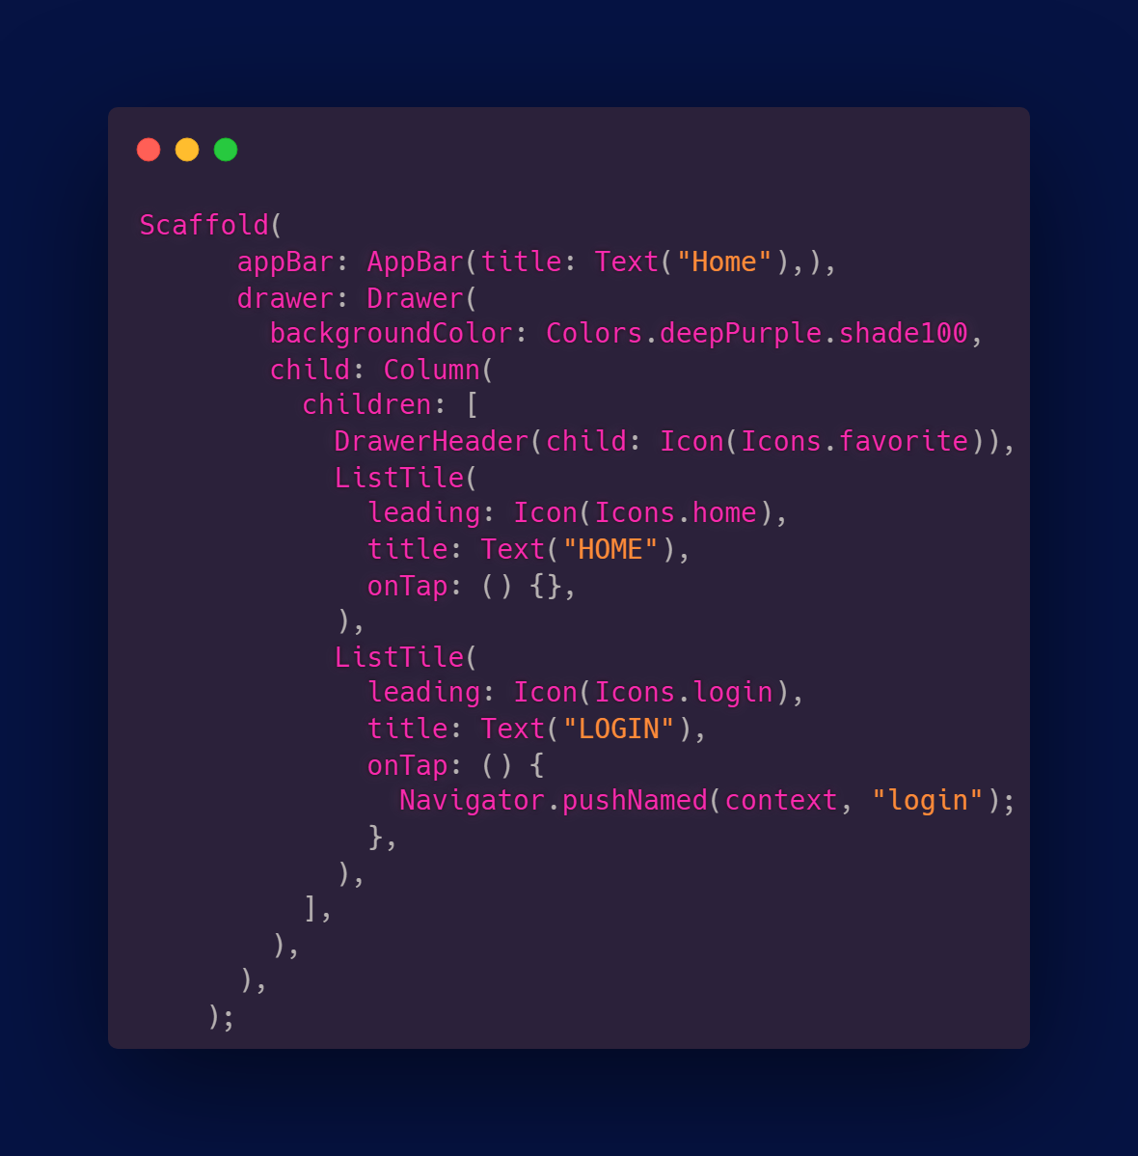
Drawer
Drawer widget is used to provide access to different destinations.
It’s represented by three horizontal lines in the upper end of the scaffold.

Slide 11
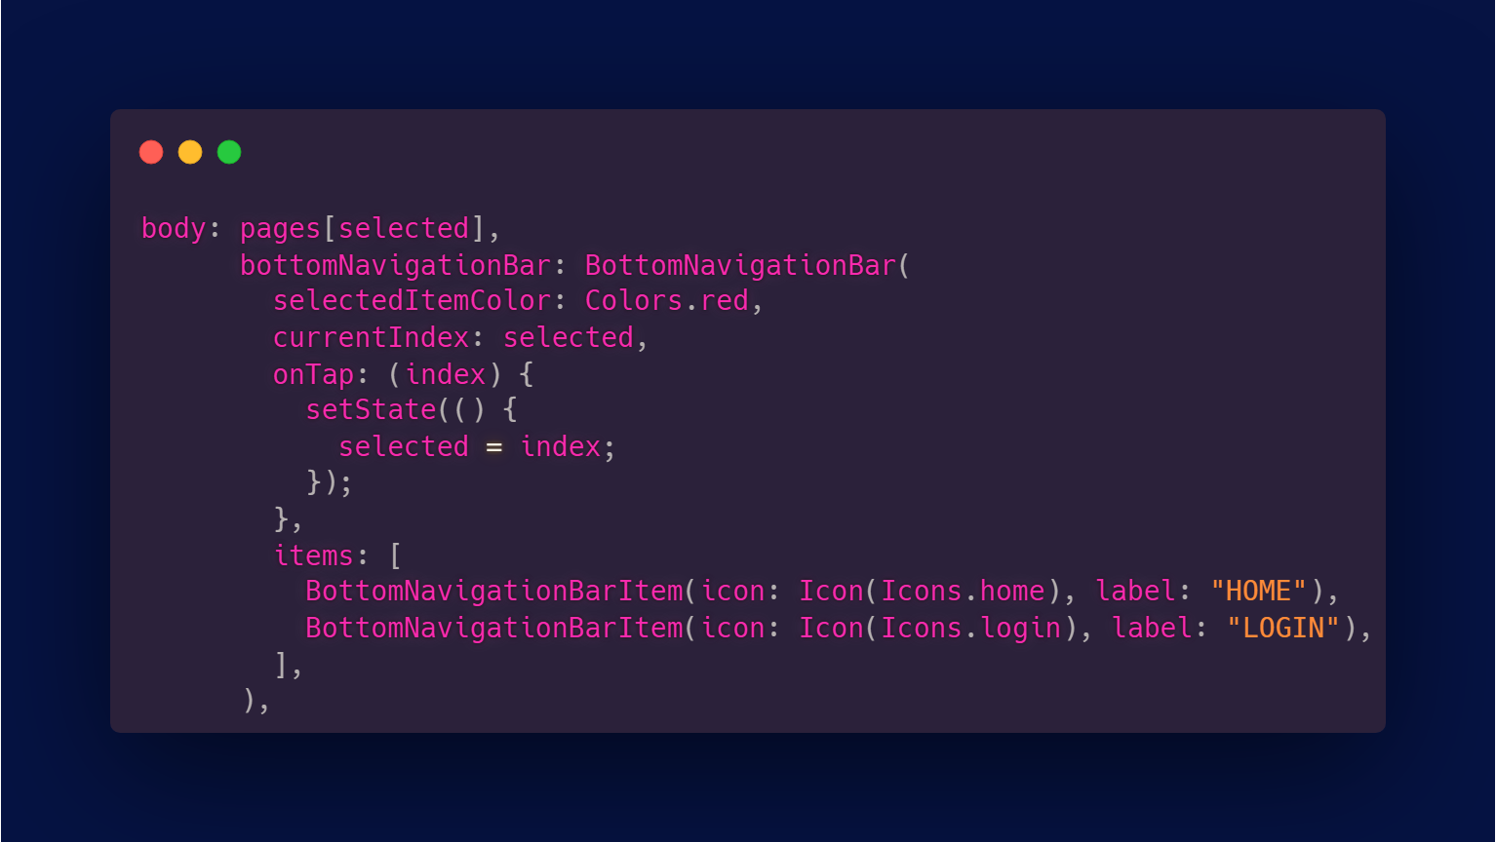
Bottom Navigation Bar
A widget that’s displayed at the bottom of the app for selecting screen routes.

Slide 12
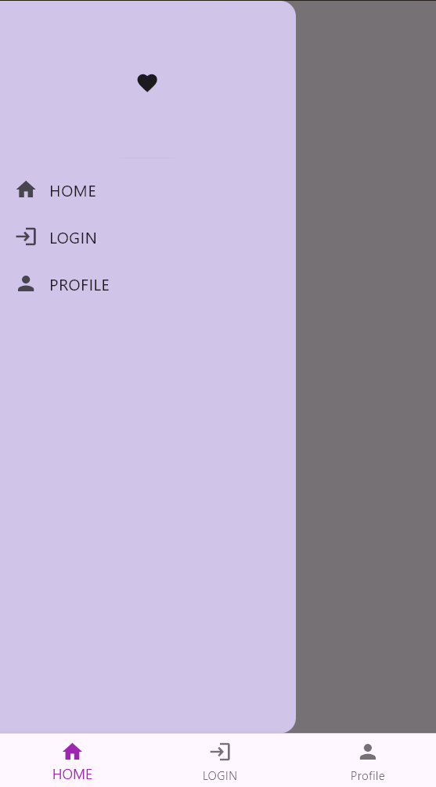
Hands on

Slide 13
Thank you!

